Slide 1

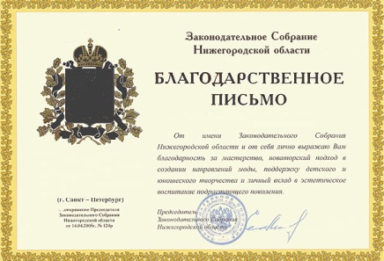

Отзывы наших клиентов
«полученный товар превзошел просто все ожидания!»
The universe is commonly defined as the totality of everything that exists including all physical matter and energy, the planets, stars, galaxies, and the contents of intergalactic space, although this usage may differ with the context
Сергей, бизнес-коуч
«лучшая компания, с которой приходилось сотрудничать»
The universe is commonly defined as the totality of everything that exists including all physical matter and energy,
ООО «Валенжи»
«лучше не бывает»
The universe is commonly defined as the totality of everything that exists including all physical matter and energy, the planets, stars, galaxies, and the contents of intergalactic space, although this usage may differ with the context
Денис, экономист
тел.:
e-mail:
сайт:
(495) 226-74-30
art@prcomm.ru
www.kit5.ru

